Slide 1


Empowering A Learning Society:
Re-imagine learning systems for 21centuary learners
4 December 2023
Accademia delle Scienze dell’Istituto di Bologna
Sungsup Ra
Deputy Group Chief and Deputy Director General Sectors Group
Asian Development Bank

Slide 2
Evolution of Education System
Industry |  |  | Education system
Hunter-gatherers | 300k years | Life skills | Informal, play and explore
Agriculture | BC 9,500 | Informal Limited | Formal edu only for a few privileged people
Industrial Revolution | 18 C | Massification | Mass education. standardization, centralization
Digitalization & AI | 21 C | Innovation Creativity | Open massive Individualization
Notes:
12,000 years ago : store foods
8,000 years ago: urbanization has started with the emergence of large villages. About BC 5000, 수메르인 최초의 도시 에리두 (Eridu)
Education 4.0 : learning anywhere anytime
learner centered
open learning
personalized learning
adaptive learning
self-directed learning
formative assessment
autonomous learning achitecture

Slide 3
300,000-year case for the 15-hour week
Work hours per week
Hunter-gatherer | 300,000-12,000 years ago | 15
Agriculture | 5th C – late 15th C | 44
 | 1200 | 31
 | 1300 | 25
 | 1600 | 41
Industry Revolution | 1750 | 58
 | 1800 | 80
 | 1840 | 69
 | 1850 | 70
Automation / Digitalization | 1960 | 41
 | 1970 | 37
 | 1980 | 33
 | 1990 | 30
 | 2000 | 28
 | 2010 | 27
 | 2019 | 26
Juliet B. Schor, The Overworked American: The Unexpected Decline of Leisure, Basic Books, 1992.
→ For data for 1750 and 1800, Hans-Joachim Voth, Time and work in Eighteen-Century London, Journal of Economic History, 1998, 29-58.
→ Post-1945 data are added and about Germany.
Notes:
고대-14 세기: 근육의 시대
르네상스-산업혁명 이전 : 과학의 시대
산업혁명 전후 약 80-100시간 노동 / week
Affluent society
To live is to work
Time is money
The death of a salary man
Productivity has been increasing exponentially for more than a century.
An average worker today needs to work a 11h/week to produce as much as one working 40h/week in 1950. But fast productivity growth has not necessarily reduced work time.
John Maynard Keynes, who forecast in 1930 that labor-saving technologies might lead to a 15-hour workweek when his grandchildren came of age. Indeed, he titles his essay, “Economic Possibility for our Grandchildren.”
FT. The 300,000-year case for the 15-hour week, James Suzman AUGUST 28 2020
‘Work: A History of How We Spend Our Time’, Bloomsbury. James Suzman
‘The Ju/’hoansi ‘Bushman’ of South Africa’s Kalahari’, Richard Lee, 1964

Slide 4
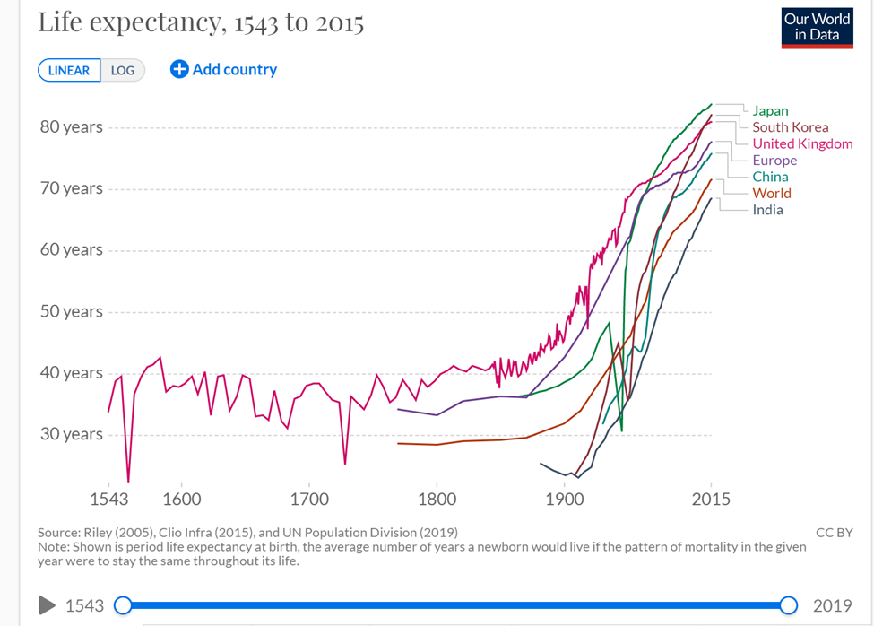
Rising Life Expectancy

Slide 5
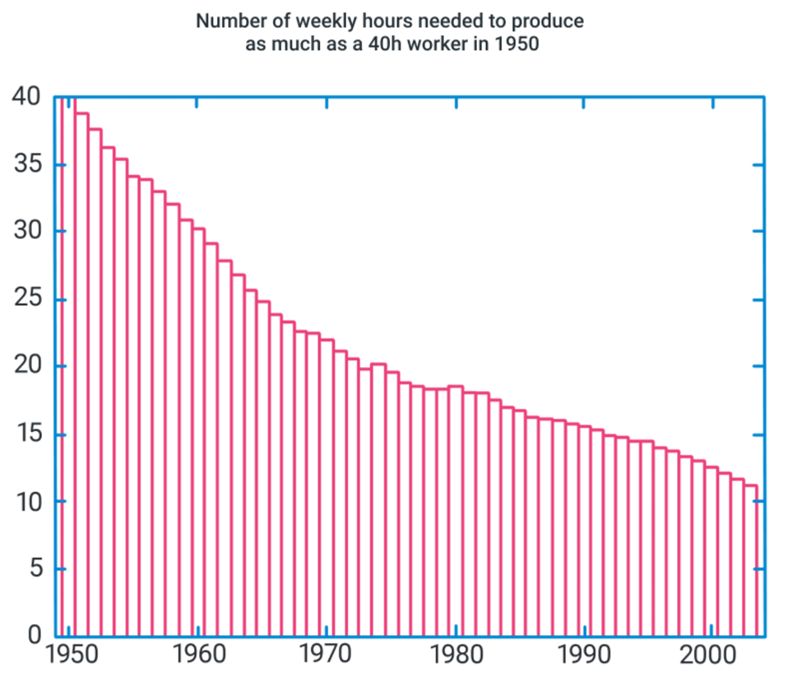
Exponential Productivity Growth
Notes:
Productivity has been increasing exponentially for more than a century.
An average worker today needs to work a 11h/week to produce as much as one working 40h/week in 1950. But fast productivity growth has not necessarily reduced work time.

Slide 6
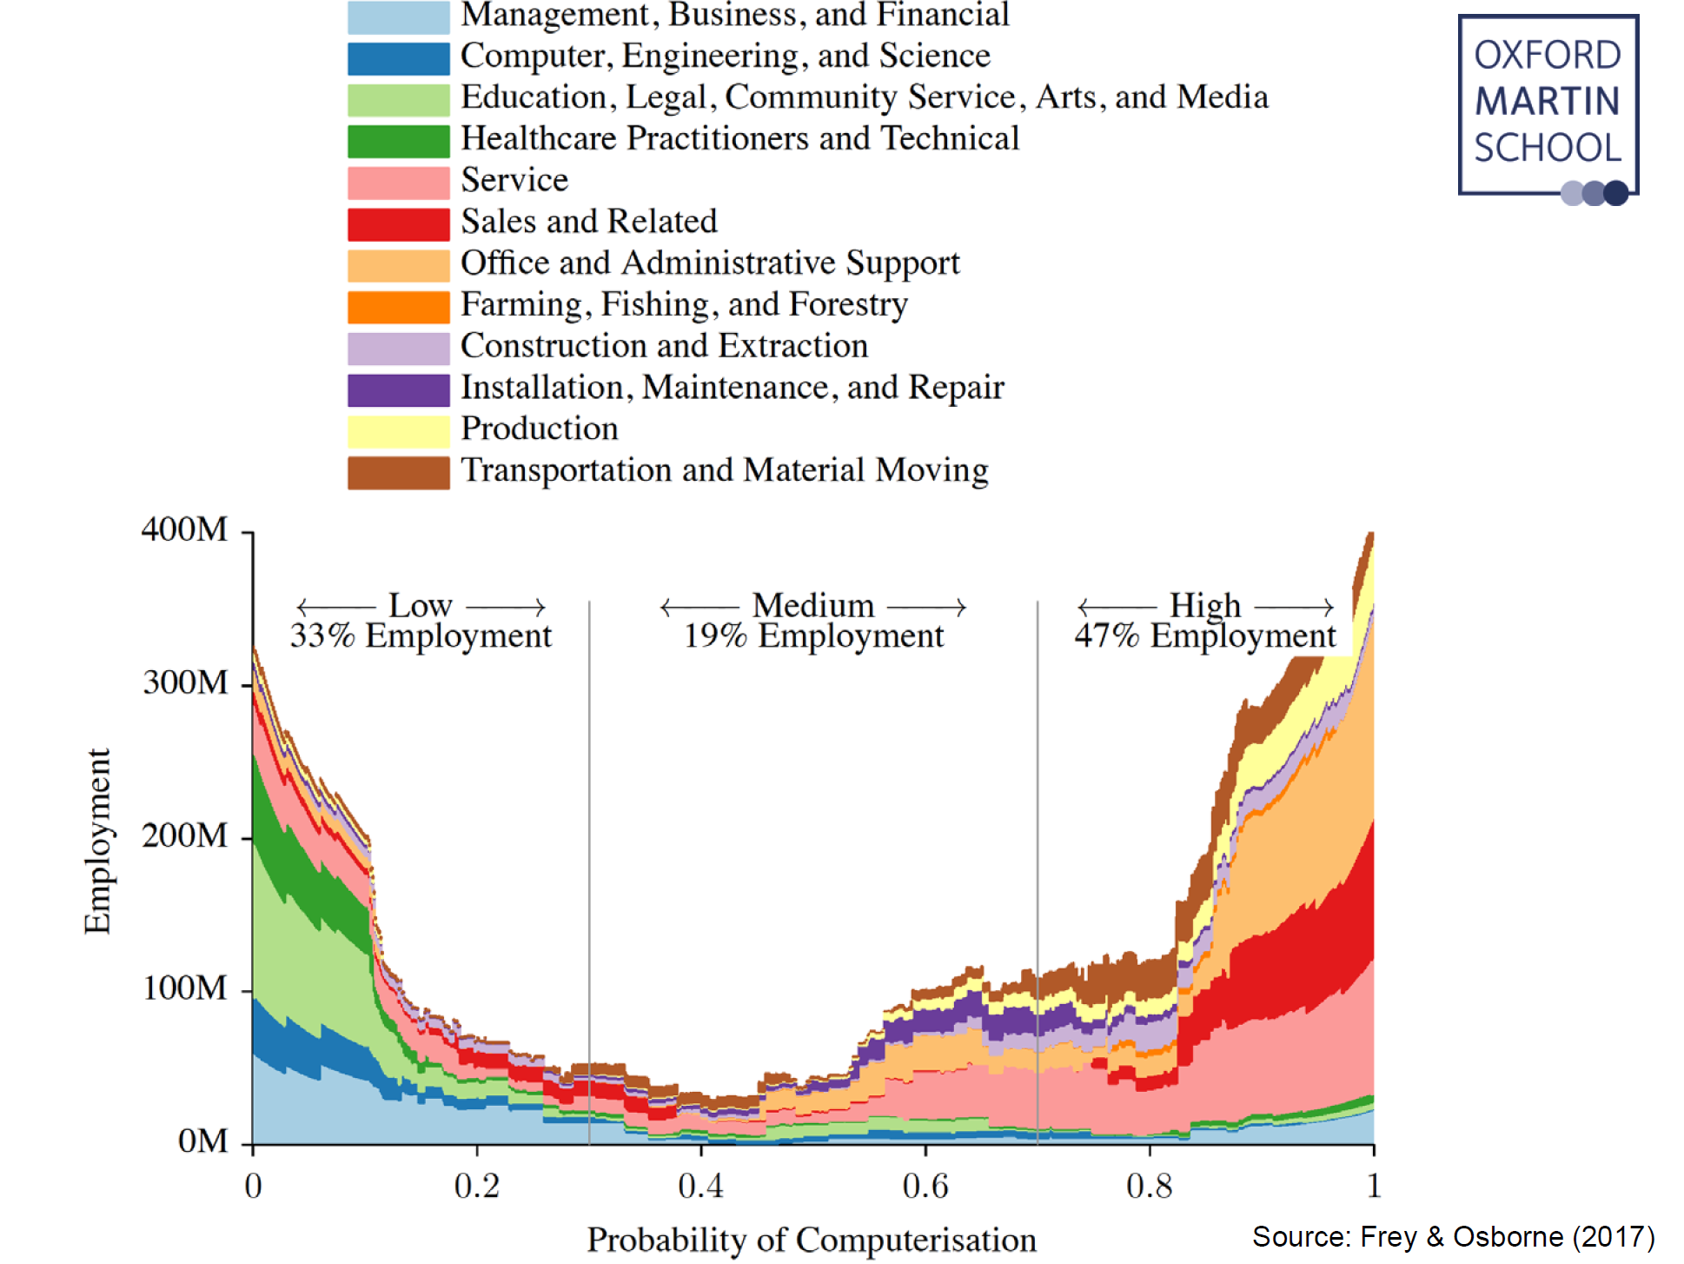
Probability of computerization

Slide 7
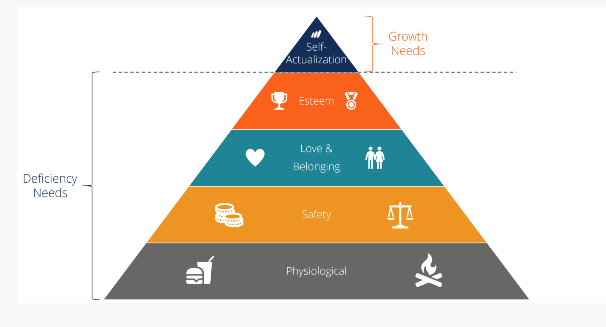
Maslow’s Hierarchy of Needs

Slide 8
What?

Slide 9
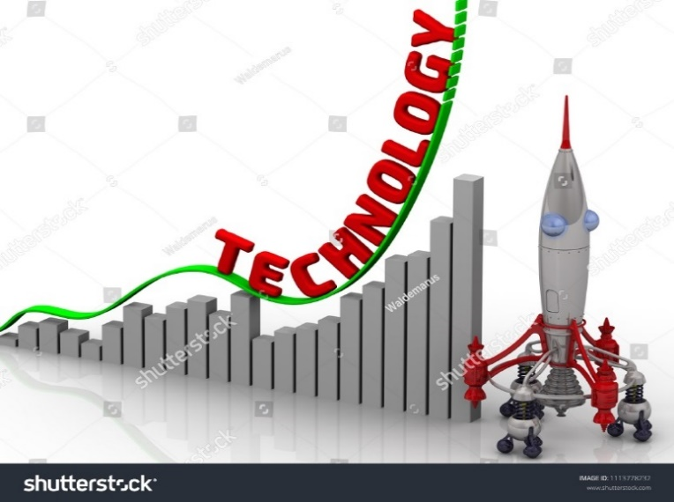
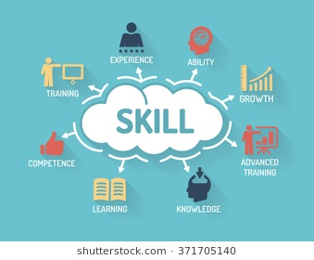



Reimagine Education
..Technology, Millennials and Future Economies
REALITIES
World change rapidly,
But education not.
Traditional
Styles
Lack of
Systems Capacity
Geometric progression
Disruptive technology
Complex skills
Fast obsolete
Open
learning styles
Uncertain future
Unknown job markets

Slide 10
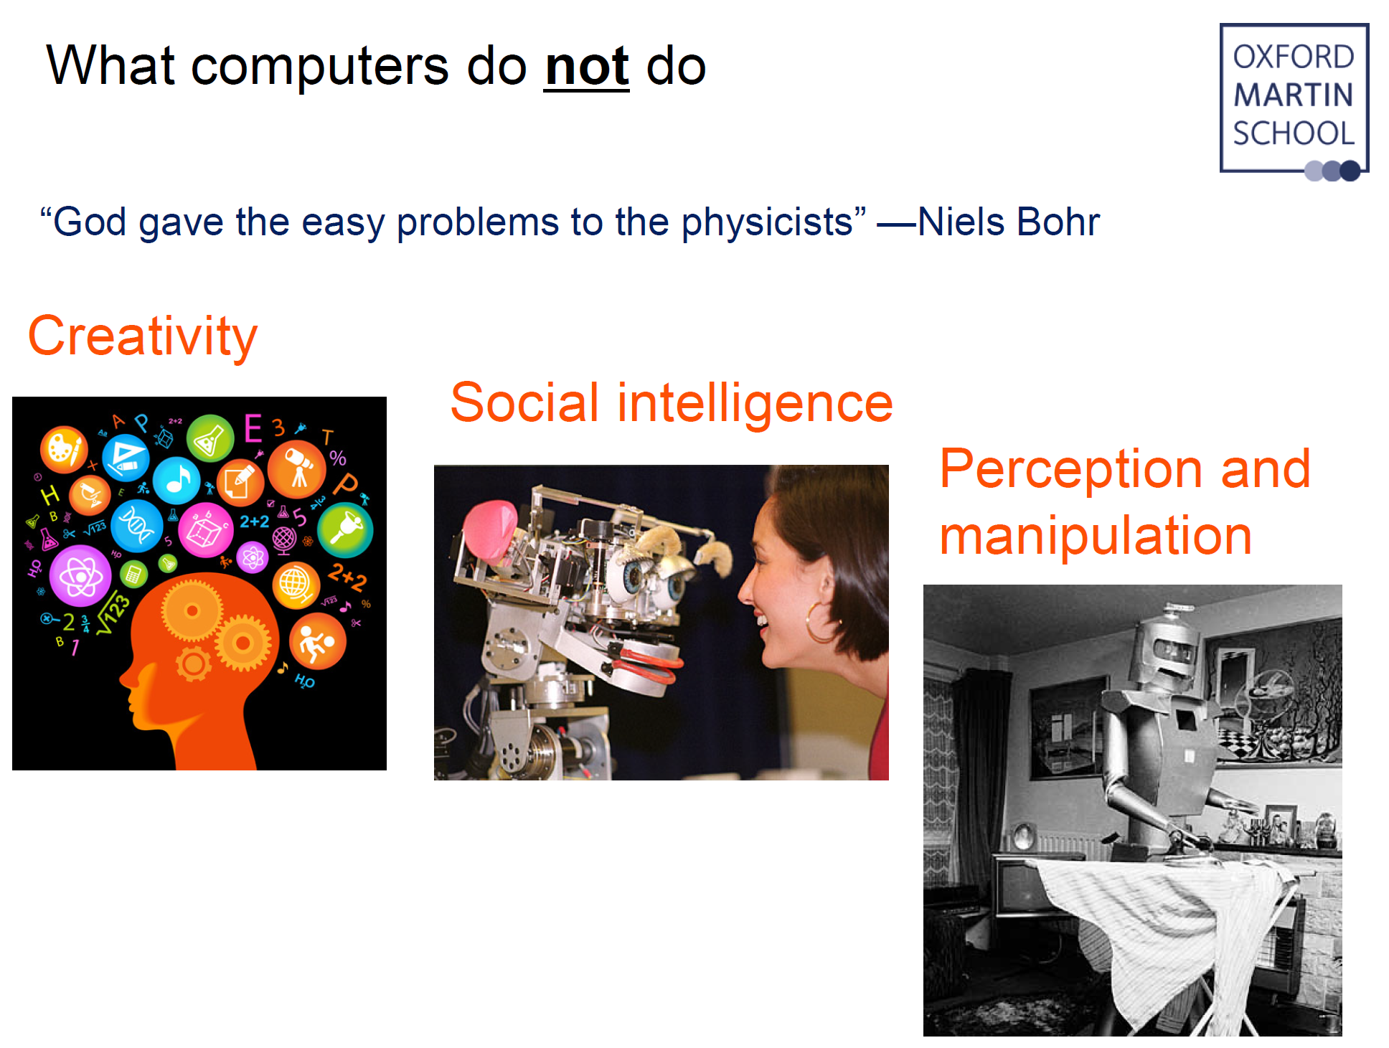

Slide 11
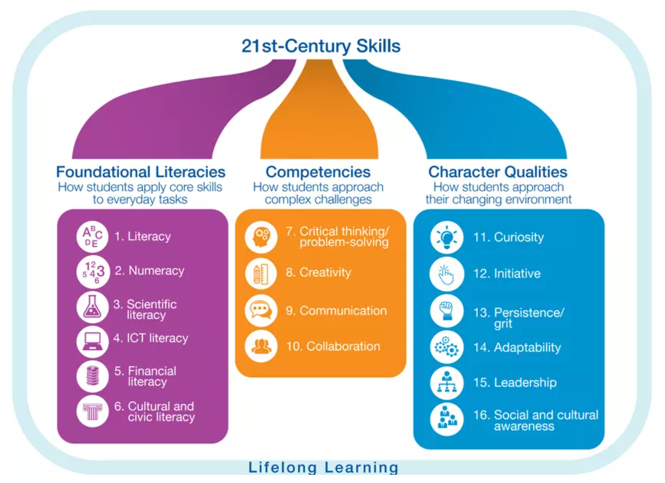

Slide 12
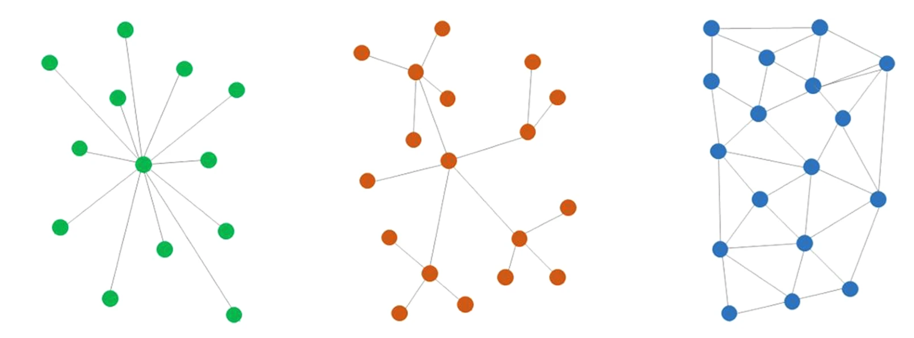
Self
Value/Purpose
Emotion/Safety
Cultural socio-economic
Lifestyle
Self-actualization (massive individualization, nationalism)

Slide 13
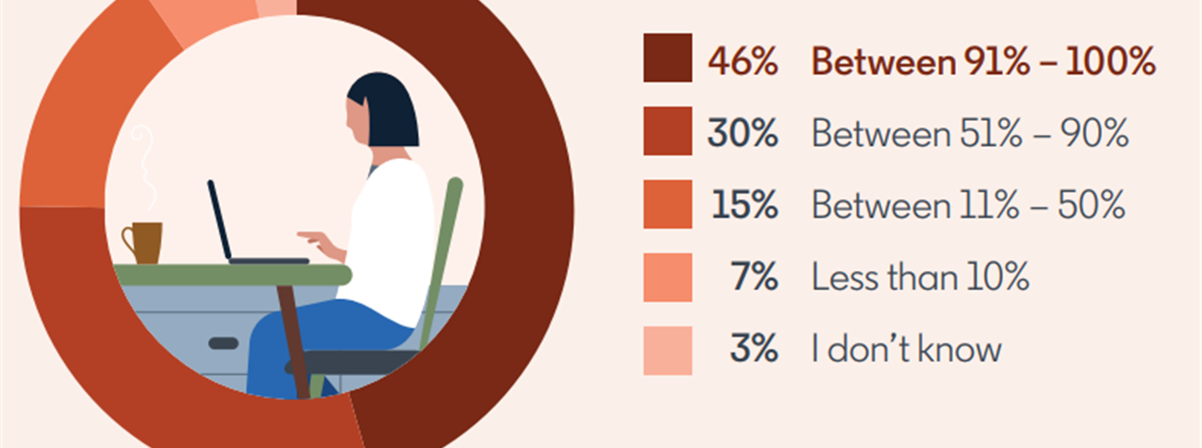
Self: Generation R
Fixed vs. Remote
Work vs. Life
Personal vs. Professional

Slide 14
Life –cycle approach
Prepare for a life of leisure / non-labor
Non labor or leisure time per day = 24- 3 = 21 hours
Actual work years = retirement age (49.4) – first job (31) = 18.4 years
Desired work years = desired retirement age (73) – first job (31) = 42 years
Lifetime(100%)= school (25%)+ labor work (22%)+post retirement (53%
or school (25%)+work (less than 10% of non-school)+non work
Notes:
통계청 2020년 5월 경제활동 인구조사 고령층 부가조사 결과 , 2020.7.28
퇴직연령 평균 49.4세 (남 51.2, 여 47.9)
실질은퇴연령 71.7 세(OECD data)
희망은퇴연령 73세
21.3년간 비정규직
근속기간 : 15년 7개월 (남 19년 3개월, 여자 11년 10개월)

Slide 15
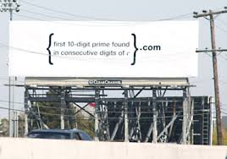

Mysterious billboard - Google
Learnability
Spaghetti marshmallow tower challenge

Slide 16
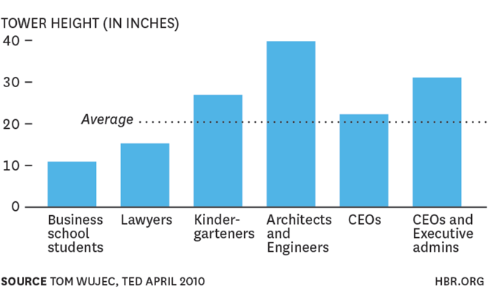
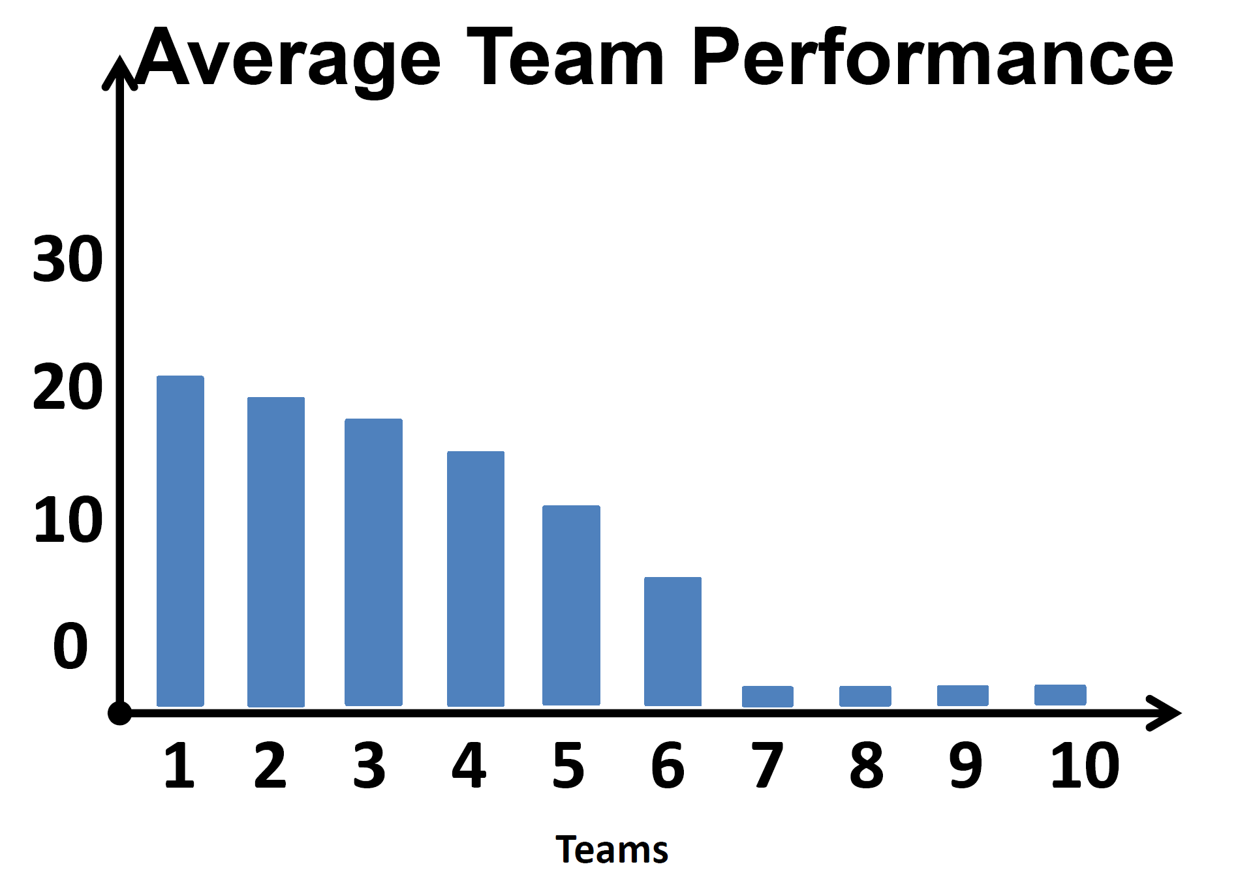
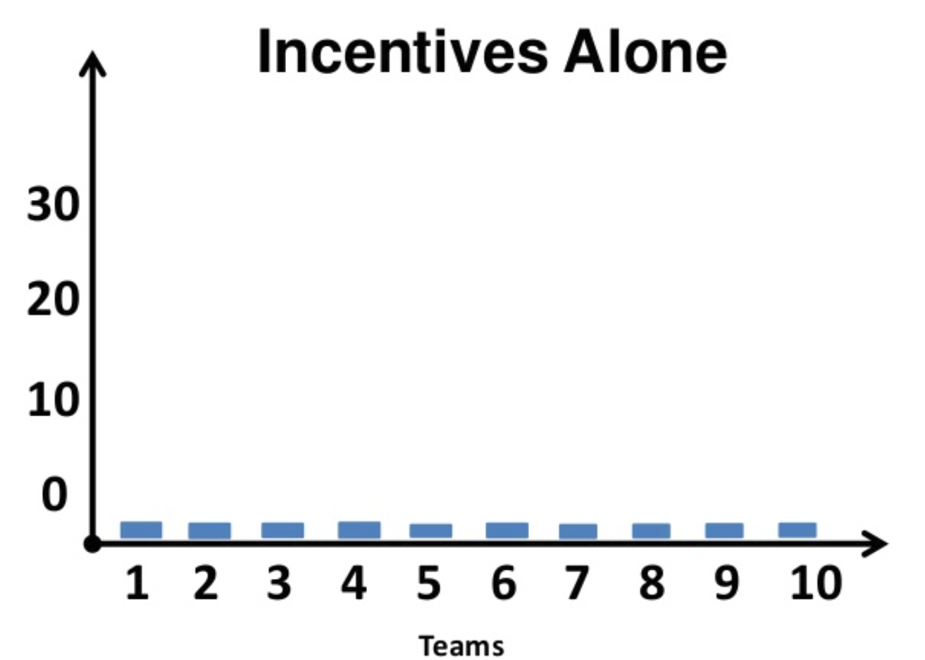
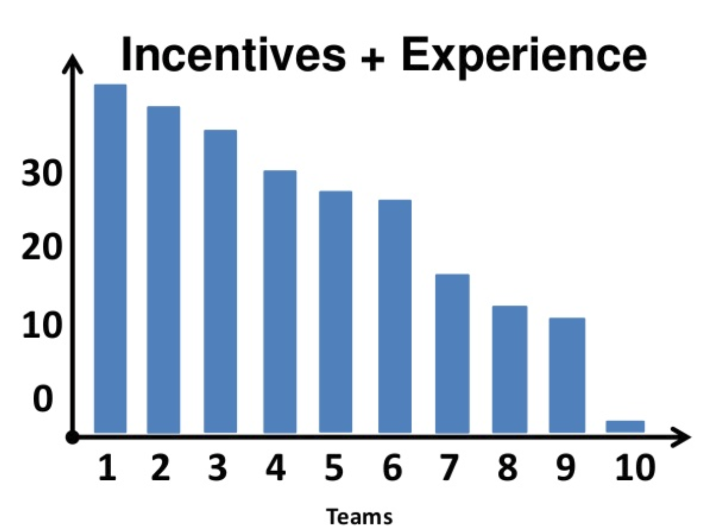
Marshmallow

Slide 17
How?

Slide 18
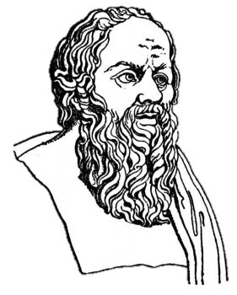
Can we emulate Socrates?
Learning beyond the classroom
Learning should have context
Schools should be an integral part of the global community
Collaborative and inquiry-based learning
Interactive, personalized, and adaptive learning
Student-centered education
Center vs empower schools/teachers
Notes:
As highlighted earlier, despite significant improvement in access, the current education systems have serious challenges in quality, efficiency , and equity. It appears that the gains of access to mass education happened at the expense of quality.
Looking back, about 2500 years ago, Socrates stimulated critical thinking and illuminated ideas through debate, not by monologue. His class was interactive, thought provoking and relevant since he discussed real world issues in the class.
Would it be possible that we emulate Socrates’ teaching and learning in our current mass education setting in every class? Here we face several problems: limited pool of qualified teachers like Socrates, resistance to change, and lack of motivation. However, as I indicated earlier, it is now feasible with innovative use of ICT.
However, in order to achieve this, fundamental , disruptive change need to take place to:
First, transform school/teacher-centered education to student-centered education.
Second, school/classroom-based learning should include experiential learning for students to learn in and outside of school, and
Third, teaching and learning should shift from the typical lecture-based style monologue to more interactive and participatory.
=====
Moreover, ICT can improve equity and unequal distribution of information. Technology can help fill the void where students can learn both in and outside of school. Students can have access to information and good quality references and resources like never before with technology. Greater expansion and access to technology will provide new opportunities. Ensuring all ICT resources are widely available for ample coverage. For example, establishing resource centers (clusters, community learning centers), networking can reach remote villages and populations.

Slide 19
3Cs
Convergence
Cooperation
Collaboration
Multi-sectoral Approach
Nano-Bio-Inf-Cogno (NBIC)
One-health
Transport-Hospitality-Health
Smart agriculture
Smart Car

Slide 20

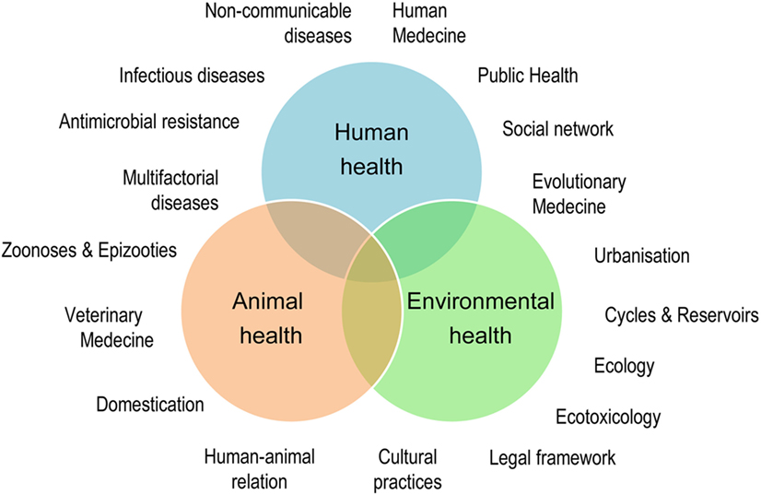
3Cs: One health

Slide 21
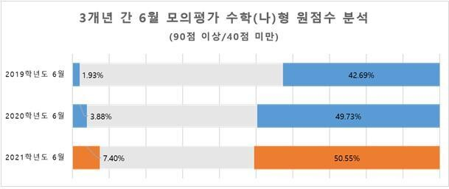
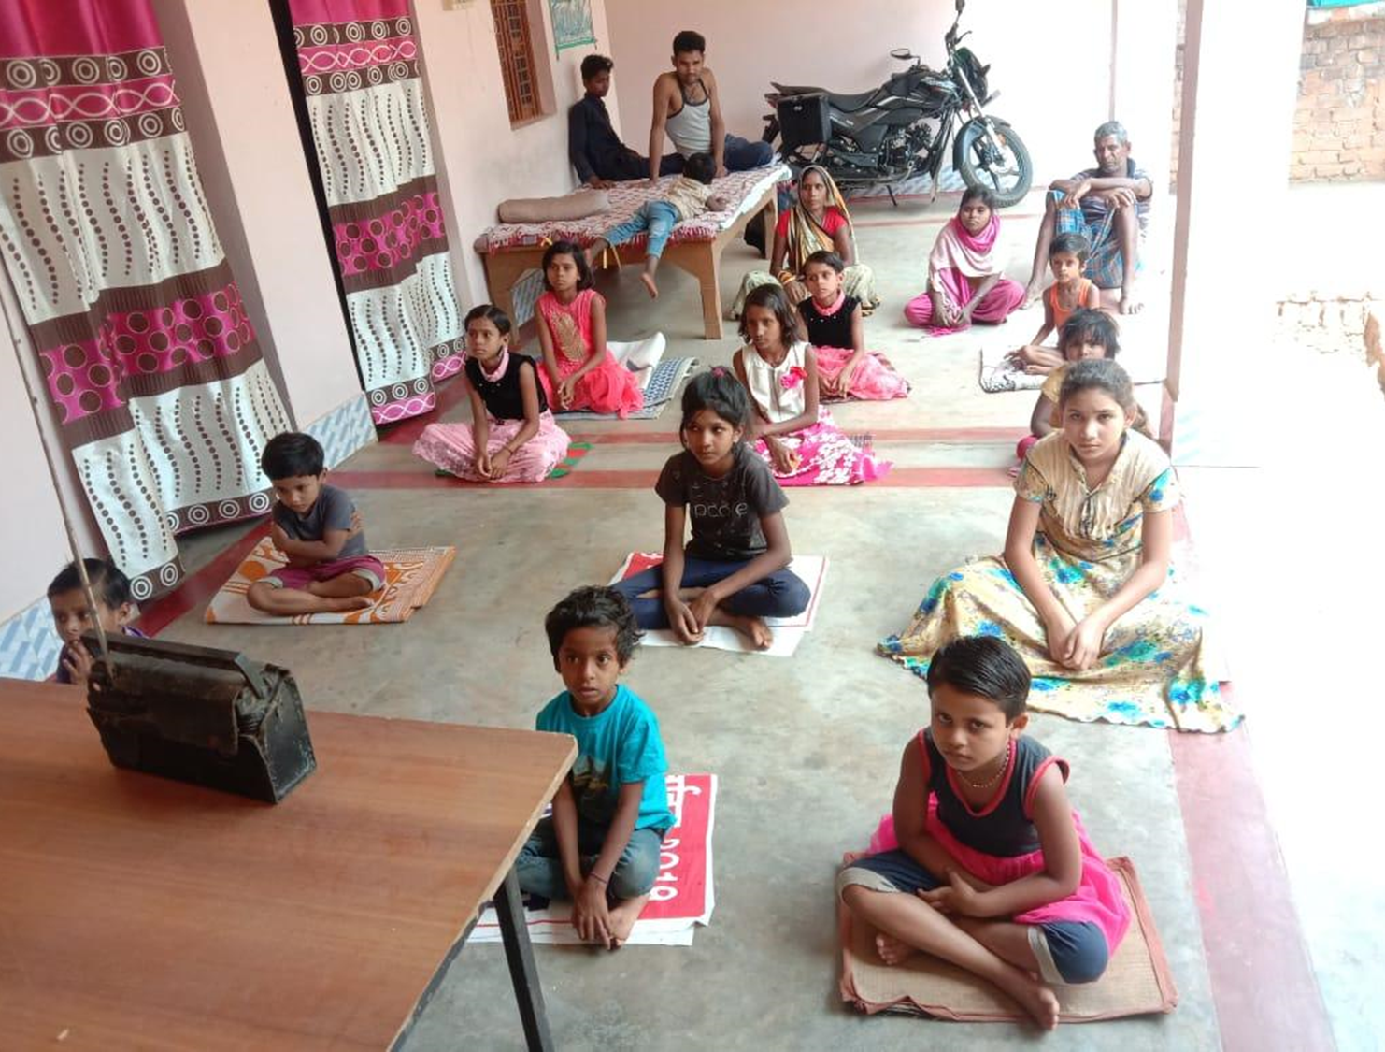
Widening gap and Collapse of Middle
http: 한계레 2020.7.28 www.hani.co.kr/arti/society/schooling/955511.html

Slide 22
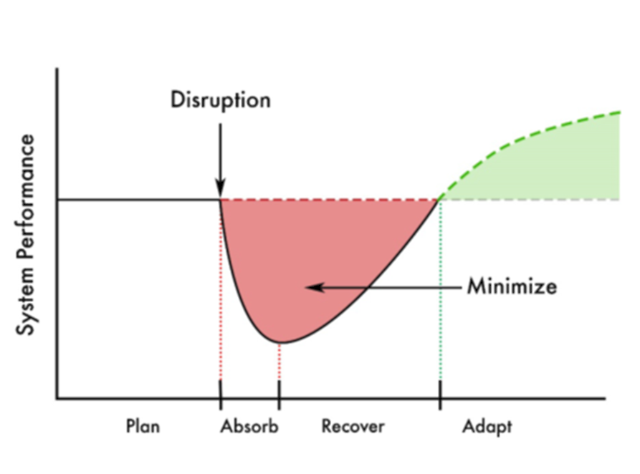
Resilience vs. efficiency
Business continuity plan
From Just-In-Time to Just-In-Case
Re-design systems (infrastructure, value chains, and economic, financial, social systems)
Source: A systemic resilience approach to dealing with Covid-19 and future shocks, OECD Policy Responses to Coronavirus (COVID-19), April 2020
Notes:
Resilience is the ability to absorb a shock. It is key to survival and long-term prosperity. More security for business is needed.

Slide 23

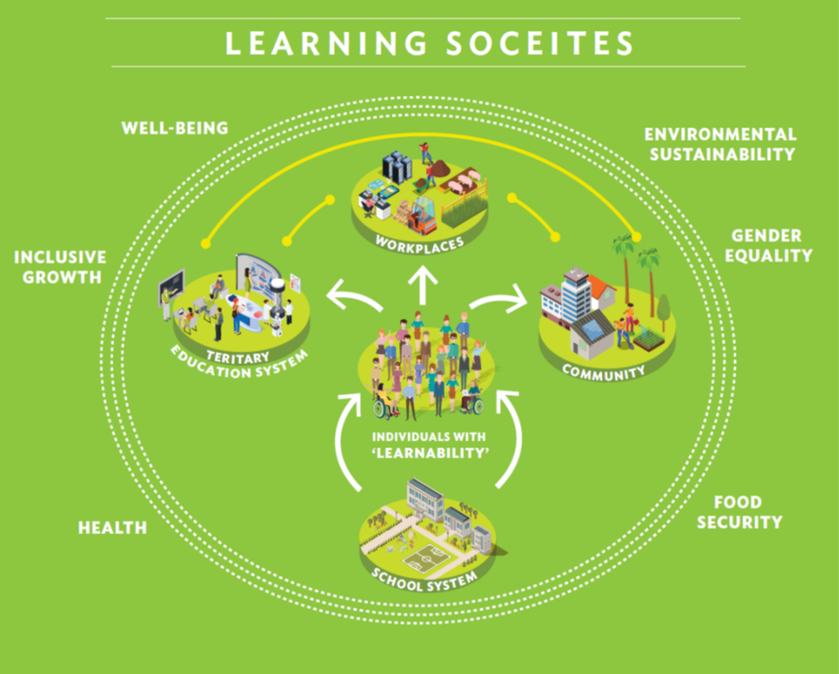
Learning Societies

Slide 24
Thank You.
rasungsup@gmail.com

